Slide 1



Comparing BERT and ELMo on a Sentiment Analysis Task using IMDb Reviews Database

Slide 2
Topics
Context dependent vs context independent embedding
A brief overview of Transformers and Encoders
The stages of training BERT
The stages of training ELMo
Sentiment analysis
IMDb dataset
Suggested architectures of BERT and ELMo

Slide 3
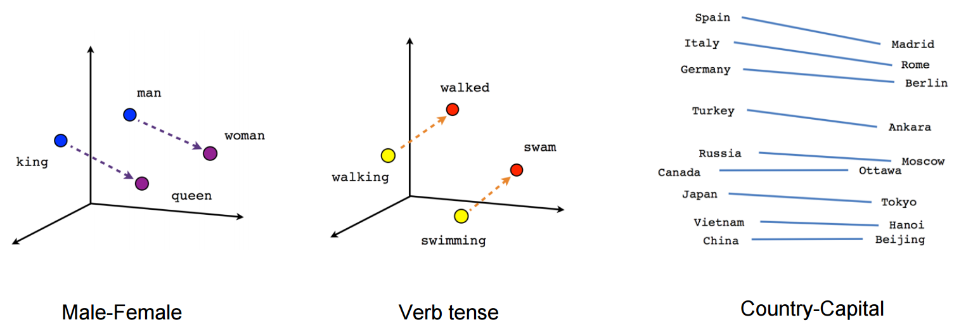
Word Embedding
Context independent embedding (Word2Vec, GLoVe)
Context dependent embedding (BERT & ELMo)

Slide 4
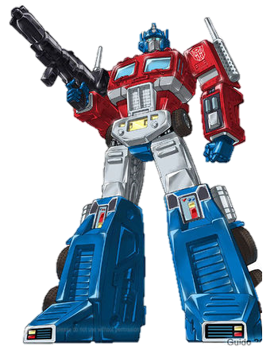
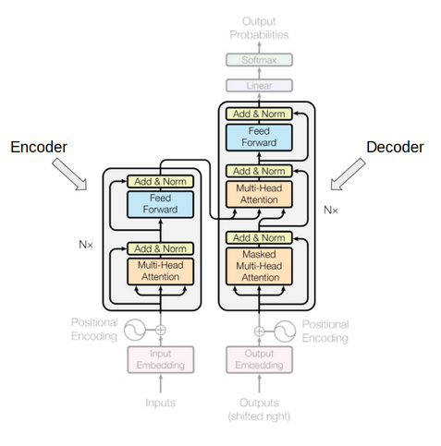
Transformers
Originally designed for language translation.
Made up of an Encoder and a Decoder.
The Encoder encapsulates the perception of a language
The Decoder encapsulates the relationship of both languages.

Slide 5
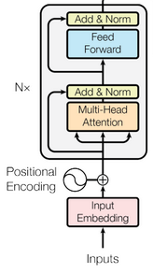
Encoders
Embedding – add a positional encoding to the naïve encoding.
Attention head – answers the question “on what part of the input should we focus?”
Feed forward - multiple feed forward networks in parallel.

Slide 6
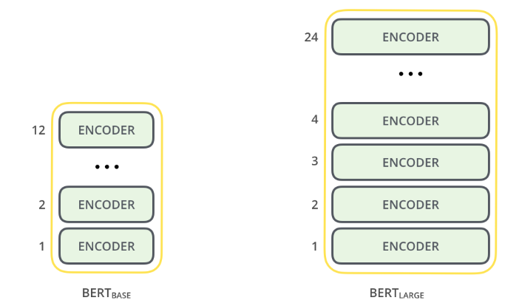
BERT (Bidirectional Encoder Representations from Transformers)
Pretty much just a stack of encoders…
Pre-training on a large corpus to “learn” the language
Pre-trained models are available online
BERT-Base – 110M parameters
BERT-Large – 340M parameters
Fine-tune a pre-trained model for specific NLP tasks.

Slide 7
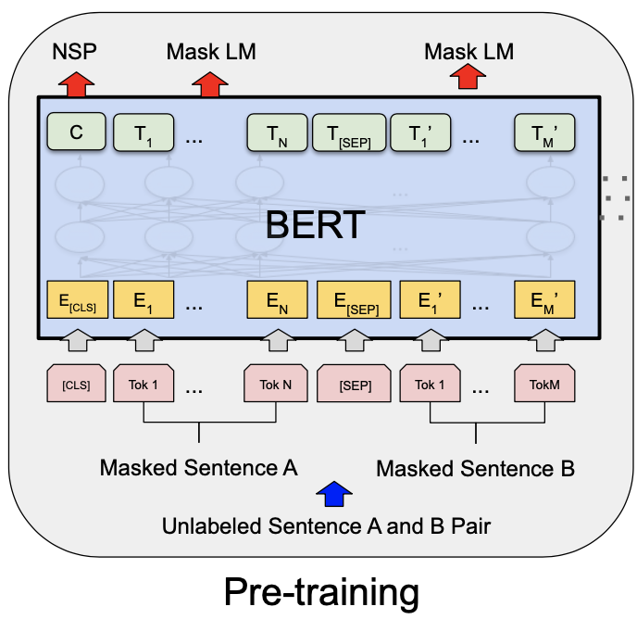
BERT – pre-training
Trained simultaneously on 2 tasks:
Masked Language Modeling (MLM)
Next Sentence Prediction (NSP)
Notes:
BERT is just a stack of encoders

Slide 8
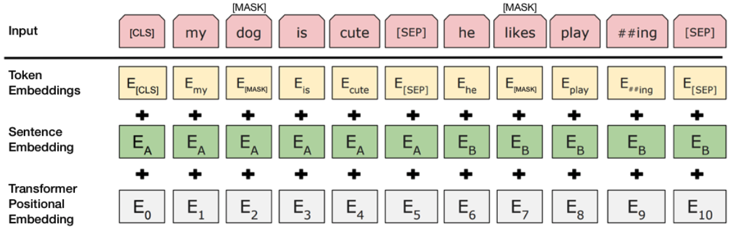
BERT – initial embedding

Slide 9
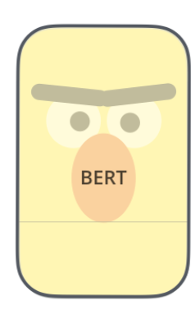
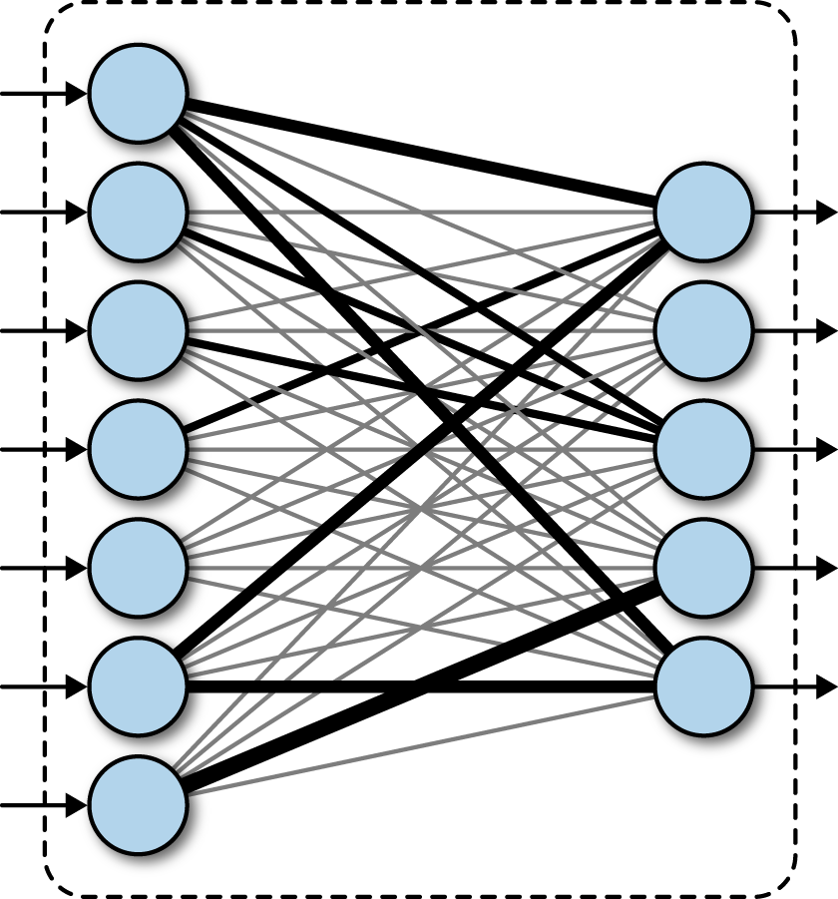

BERT – fine-tunning
Replace fully connected output by new fully connected layer
The new layer is where the specific task is learned
Notice – we do not train for many epochs! most of the bottom layers have already been perfectly weighted from the pre-training step and we don’t want to change them.

Slide 10
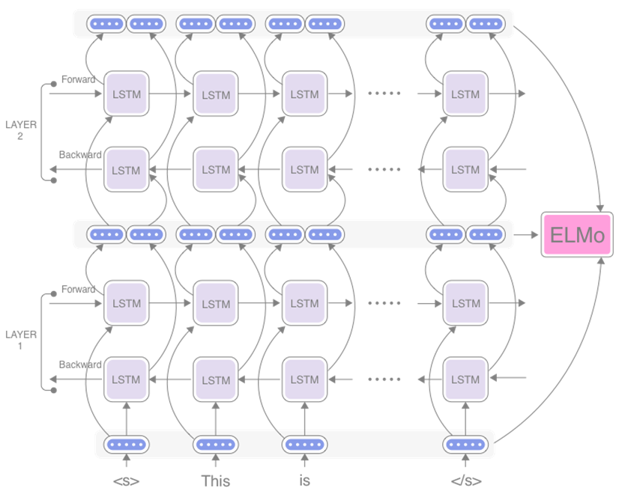
ELMo (Embeddings from Language Model)
ELMo is a context inclusive word embedder
Two-layer bi-directional LSTM
One layer reads left-to-right, one reads right-to-left
Captures the context from both sides

Slide 11


Sentiment Analysis
Interpretation of sentiment, opinion or subjectivity in text
can be interpreted as a classification task where each category represents a sentiment
Sad
Happy

Slide 12
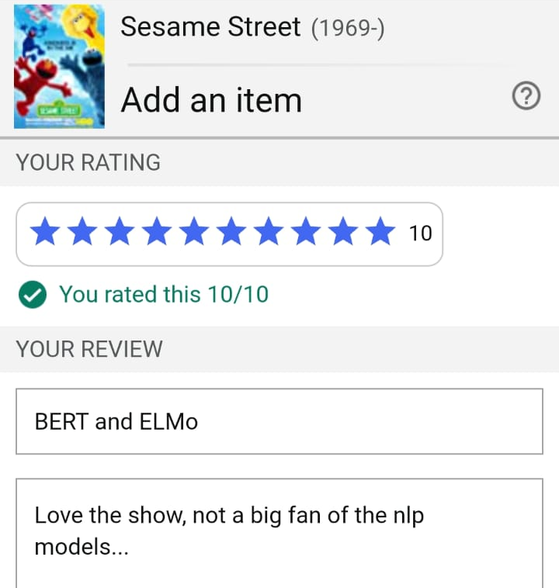
IMDb dataset
50K reviews - 25K positive, 25K negative
Train and test split equally and evenly
Positive reviews -> rating >= 7/10
Negative reviews -> rating <= 4/10
Rating
Review

Slide 13

Architectures
ELMo
Trainable ELMo
4 trainable scalar weights
1024 outputs
Dense layer - 256 outputs
Dense layer - 2 outputs (Positive & Negative review) with softmax activation
BERT
Pre-trained BERT-Base
12 Encoder layers
12 Attention heads
768 outputs
Dense layer - 768 outputs
Dense layer - 2 outputs (Positive & Negative review) with softmax activation
Drop-out layers before each dense layer to prevent overfitting
Both models – 3 epochs, batch size of 50

Slide 14
Thank You!

